Slide 1



Online Requisitioning and Approval
WSU EXPERIENCE

Slide 2

Understanding Online Requisition
Presented by: Z MAKOM
Date: 11-March-2025

Slide 3


TOPICS
Introduction and background
Manual Process, Challenges and Solutions
Staff Setup
Non-Defined Item Requisition Process
Requisition Approval Process
Finance Vetting
Payment Requisition Process
Querying a Requisition Status
Key Takeaways
Q&A Session

Slide 4
Introduction: Manual to Automated Requisition Processes
Requisition and approval processes have traditionally been handled manually, requiring paper-based documentation, multiple physical approvals, and time-consuming follow-ups.
This often leads to delays, errors, and inefficiencies due to misplaced documents, miscommunications, and lack of real-time tracking.
It would normally take three days to a week for the requisition to be finally approved for placing an order.
See the following manual process steps

Slide 5
Manual Process Flow
The user sends an email request for quotations to procurement
The buyer sources quotations by fax/ email with a telephone follow up
The buyer sends the quotations to the user
The user prepares the manual requisition with the quotations attached
The requisition book is signed by the HOD/ Executive to approve the purchase
Notes:
The Finance iEnabler System aims to streamline requisition and payment processes. Key roles include requestors, buyers, approvers, and the finance team.
Original Content:
Overview of the Finance iEnabler System
Purpose: Streamlining requisition and payment processes
Key Roles: Requestors, Buyers, Approvers, Finance Team

Slide 6
Manual Process Flow continued
The user takes the requisition book to budget
Budget confirms availability of funds by inserting the budget, commitments available funds and sign the requisition
Procurement is allowed up to three days to process depending on the commodity
Finally, an order is issued and sent to the Finance Manager for approval
The user takes the requisition to procurement to place the order
The signed order is sent to the supplier, and goods get delivered when available
Notes:
The Finance iEnabler System aims to streamline requisition and payment processes. Key roles include requestors, buyers, approvers, and the finance team.
Original Content:
Overview of the Finance iEnabler System
Purpose: Streamlining requisition and payment processes
Key Roles: Requestors, Buyers, Approvers, Finance Team

Slide 7
Challenges and Solutions
This manual processes presented a huge challenge (slow, inefficient, impossible to track) for WSU
Resulted in underspending and poor service delivery (student affairs, teaching and learning) and procurement was to blame.
The CFO engaged Adaptit to find solutions to the challenges of the manual workflow and inefficient procurement processes.
We were then introduced to iEnabler (we were paying for the module but not using it).
Notes:
The Finance iEnabler System aims to streamline requisition and payment processes. Key roles include requestors, buyers, approvers, and the finance team.
Original Content:
Overview of the Finance iEnabler System
Purpose: Streamlining requisition and payment processes
Key Roles: Requestors, Buyers, Approvers, Finance Team

Slide 8
Where we are now
Following the implementation of the online requisition system, these challenges were significantly reduced.
Automated processes streamline workflow by digitizing approvals, improving transparency, and ensuring compliance with financial procedures.
Users can easily track requisition statuses, approvals happen faster, and integration with budget controls enhances financial management.
Users do not have to leave their offices everything is done while seated at the comfort of their office.
Notes:
The Finance iEnabler System aims to streamline requisition and payment processes. Key roles include requestors, buyers, approvers, and the finance team.
Original Content:
Overview of the Finance iEnabler System
Purpose: Streamlining requisition and payment processes
Key Roles: Requestors, Buyers, Approvers, Finance Team

Slide 9

Staff Setup planning
Staff Roles
  Designated as requesters
  Designated as approvers
Requisition Processing
  Tied to cost centers
Approval Hierarchy
  Head of Department (HOD)
  Deputy Director
  Director
  Executive Manager

Slide 10

Staff Setup on the system
Requesters
  Requesters are linked to cost centers
Approvers
  Approvers are linked to Policy Rules
  which determine the number of approvers based on the delegation of Financial Authority and SCM Policies
Approval Hierarchy
  Head of Department (HOD) – R50k
  Deputy Director – R250k
  Director – R1m
  Executive Manager – above R1m

Slide 11

Non-Defined Item Requisition Process
Requestor creates and submit requisition
Budget Vets the requisition
Manager Approves
Buyer issues approved order
Goods/ services are received ☺
Routed to the selected Buyer
Buyer sources quotations
Quotation are added to the requisition
Buyer completes maintenance of requisition
This process involves buyers
Both goods and service can be procured
Budget is also involved in this process and budget shifts are possible
The existing delegation of authority identifies approvers

Slide 12
Log into iEnabler
Select Finance iEnabler, select Requisitions
Cleck on Create Requisition, then Click here and select View/ Upload-Finance Requisition

Slide 13
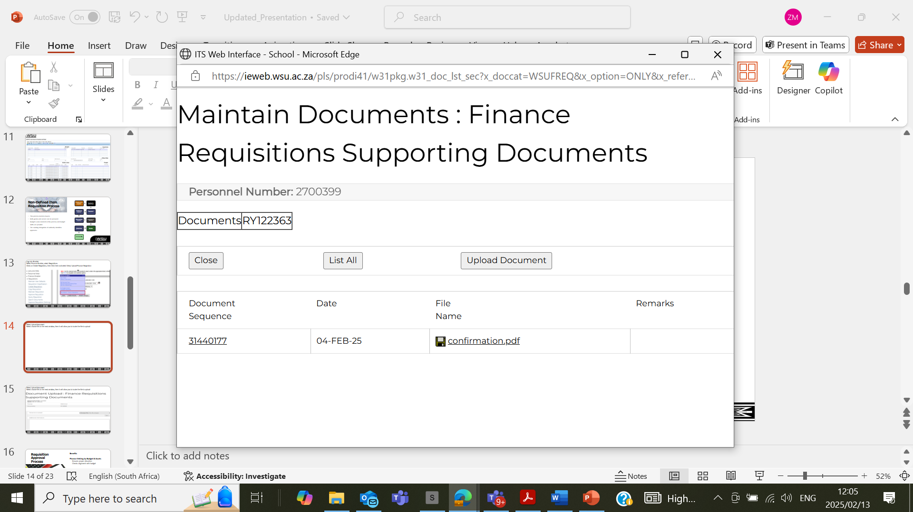
Select Upload document, another window will open to choose file

Slide 14
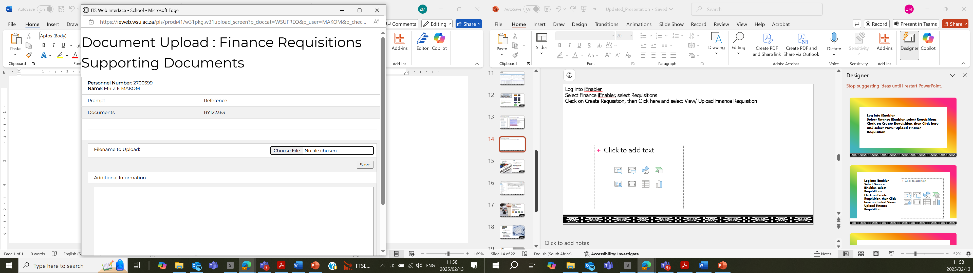
Select choose file, then it will allow you to locate the file to upload

Slide 15
Select Add Non-Defined Item

Slide 16
Complete the Quantity, Unit, Item Description, Cost Centre and Account then click the trolley

Slide 17
Select Delivery Instructions

Slide 19
Click here and select Complete Requisition

Slide 21
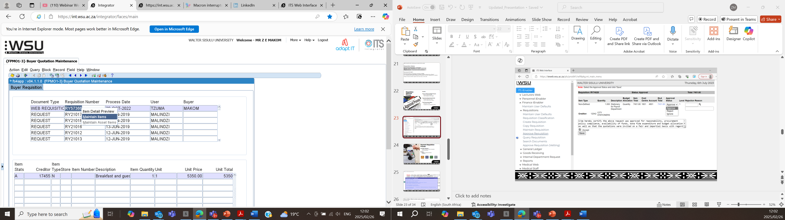

Slide 22

Requisition Approval Process
Benefits
Finance Vetting by Budget & Assets
  Ensures proper allocation
  Checks alignment with budget
Approval by Departmental Heads
  Involves HOD, DD, or Dean
  Confirms departmental support
Final Processing by Buyer
  Generates an order
  Completes the procurement process

Slide 24
Finance Vetting
Three years into the new automated system, when everyone was happy with it, we introduced other additional steps into the process.
The additional steps were necessitated by the misallocation of transactions.
Most challenges were experienced by our assets and budget teams
Requesters were using whichever accounts they find with budget irrespective of the
nature of the account, including buying stationery from assets(Capex) accounts

Slide 25
Finance Vetting
The following steps were introduced
    Senior buyer Vetting – Approve Requisition(Vetting) on iEnabler
    Budget Office Vetting – Finance Requisition Vetting on back office, verify the correctness of accounts, fix if incorrect and indicates if the item is an asset
    Assets Vetting – Maintain Assets Items on back office, if the item is an asset, if not the requisition will be rejected
Only when all the applicable steps are completed the requisition will be routed to the approver

Slide 26

Payment Requisition Process
Non-Order Payments
  Includes refunds to staff and students
  Once-off payments
Routing
  Directed to Payments Section (Creditors)
Manager approves
Payment of goods or services
Requestor creates and submit requisition
Creditors maintains requisition

Slide 27
Click here Select Add Payment Item

Slide 28
Click on Other/ Other for other service providers

Slide 29
Click on the search icon to search for the creditor code and select from the provided list

Slide 30
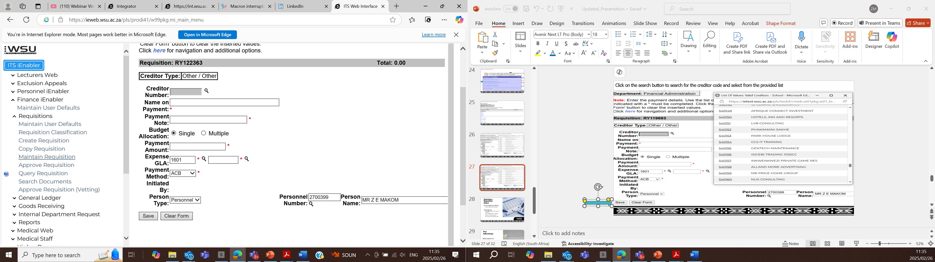
Complete the mandatory fields and click the Save button at the bottom

Slide 31
Click here and select Complete Requisition

Slide 32

Querying a Requisition Status
Access through Finance iEnabler
  Use RY number to track status
Status Indicators
  Verify/Buyer: Buyer must maintain requisition
  Funds: Budget transfer required
  Approval: Awaiting approval
  Final: Buyer must generate order

Slide 33

Key Takeaways
Efficient requisition and approval
  Streamlines the process of requesting and approving financial transactions
  Reduces time and effort required for approvals

Slide 34
Key Takeaways
Ensuring compliance with financial procedures
  Helps maintain adherence to established financial controls
  Minimizes the risk of errors and non-compliance
  Requisition tracking
  Performance management

Slide 35


Slide 36

Q&A Session

